Slide 1







Lecture 9:
Introduction to Express.js
Course - Web Development - III
-By
Pratik Raj Verma
welcome@krmangalam.edu.in
Sohna Road,Gurugram,Haryana 122103

Slide 2

| Table of Contents
Express.js
Express vs HTTP module
Creating server
References.
The End.

Slide 3


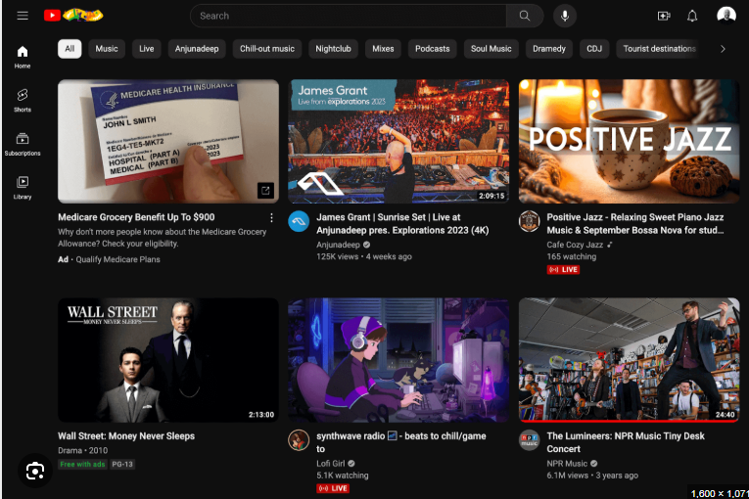

|
Have you ever noticed where YouTube videos actually come from, how a WhatsApp message instantly reaches another person’s phone, or where the data goes when we upload a photo on Instagram?

Slide 4
|
Have you ever noticed where YouTube videos actually come from, how a WhatsApp message instantly reaches another person’s phone, or where the data goes when we upload a photo on Instagram?
All these things happen with the help of a Backend Server.
When you open Instagram, the frontend (the app you can see) sends a request to a server. That server finds data from the database and sends it back.
Example:
Instagram → sends request for posts
Server → fetches posts from database
Database → returns data
Server → sends response to app
App → shows posts on screen
Same thing happens everywhere:
Login verification
Sending messages
Uploading photos
Watching YouTube videos

Slide 5
| Express Js
So today we are going to study the technology that helps us create these backend servers.
And that technology is called… Express.js
Express.js is a fast, lightweight, and flexible web framework for Node.js that helps developers build web applications, APIs, and backend servers easily.
It provides many important features such as:
Routing → Helps define different URLs like /login, /signup, /profile
Middleware → Allows us to run functions between request and response
Request & Response Handling → Makes it easy to access user data and send responses
REST APIs → Helps create APIs for frontend and mobile applications
Integration with Databases → Easily connects with databases like MongoDB or MySQL

Slide 6
|
If we can already create servers using Node.js HTTP module, then why do developers still prefer Express.js? What problems was Express trying to solve.

Slide 7
| Express vs HTTP module
Why Use Express.js Over Node HTTP Module?
Node.js HTTP module can already create servers, but it requires more manual setup and extra code. As projects grow larger, handling routes, requests, responses, and APIs using only the HTTP module becomes difficult and messy.
Express.js simplifies backend development by reducing boilerplate code and providing built-in features like routing, middleware, and easier request handling.

Slide 8
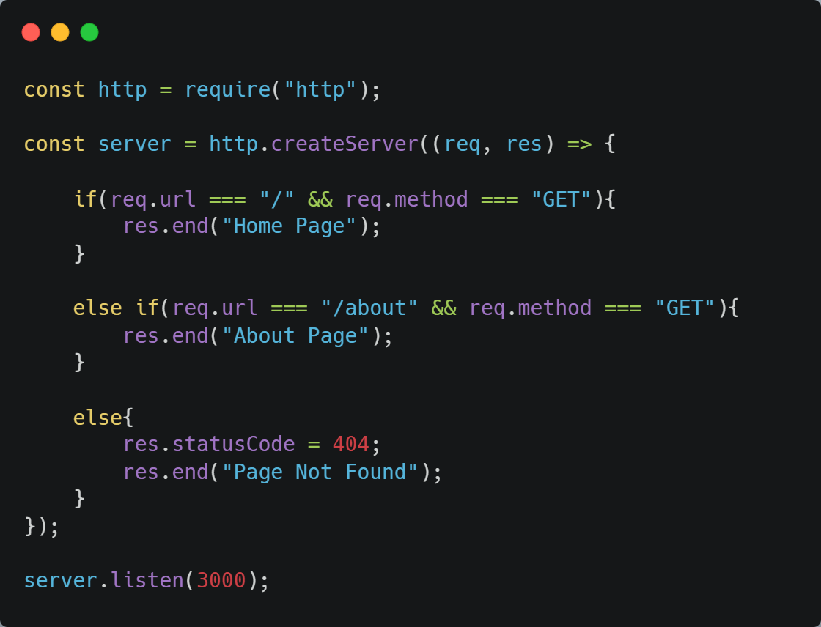
| Express vs HTTP module
Right now, backend development using the HTTP module may look difficult and confusing because we are handling everything manually
Problem:
Manual routing
Manual method checking
More boilerplate code
Hard to manage in large projects

Slide 9

| Express vs HTTP module
But here’s the exciting part 👀
Now we are going to learn Express.js, which makes backend development much simpler, cleaner, and faster. The same server that looks lengthy and complex right now can be built in a much easier way using Express.
Once you understand Express.js properly, your fear of backend development will start disappearing, and creating APIs and servers will begin to feel much more natural and interesting.

Slide 10


| Installing Express
Today we are going to install Express.js inside our project and create our first backend setup.
Step 1 — Create Project Folder
Open terminal and run:
Explanation
mkdir means → make directory/folder
backend is the project folder name
Now move inside the folder:

Slide 11


| Installing Express
Step 2 — Open Project in VS Code
What is npm?
npm stands for:
Node Package Manager
It is used to:
install packages
manage dependencies
handle project libraries
Explanation
code . opens the current folder in VS Code
. means current directory
Step 3 — Initialize Node Project
Explanation
npm init -y
This command creates a Node.js project automatically.

Slide 12

| Installing Express
It generates:
package.json
What is package.json?
package.json stores:
project information
installed packages
project dependencies
scripts
It acts like the identity card of the project.
Step 4 — Install Express
After installing Express: node_modules/
Package-lock.json
will automatically be created.

Slide 13
| Installing Express
Step 5 — Create Main Server File
Create: server.js
Main entry point of backend application.
What Happens Inside server.js ?
Inside server.js we usually:
create Express server
configure middleware
connect routes
start the server
connect database
So this file controls the complete backend application.

Slide 14
| Installing Express
1. node_modules
Folder Structure :
This folder contains:
installed packages
Express source code
all dependency files
express-app/
│
├── node_modules/
├── package.json
├── package-lock.json
└── server.js
2. package.json
Stores:
package versions
File information
4. server.js
Main entry point of the backend project.
This is where we will write our Express server code.
3. package-lock.json
Stores:
exact package versions
dependency tree

Slide 15
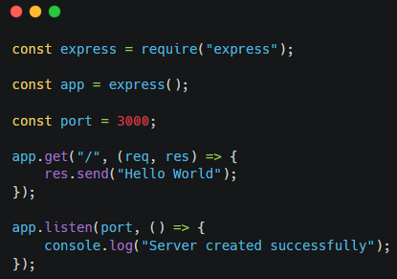


| Creating Server using Express
Line 1 — Import Express
Explanation
require() is used to import packages/modules
Here we are importing the Express package
express now stores all functionalities of Express.js
Simple Meaning
“Bring Express.js into this project so we can use it.”
Line 2 — Create Express Application
Explanation
express() creates an Express application
app becomes our backend server object

Slide 16


| Creating Server using Express
Line 3 — Create Port Variable
Explanation
Stores port number inside a variable
A port is like a room number inside a building
Different applications run on different ports.
Line 4 — Create Route
Understanding req and res
req → Request Object
browser request data
URL
headers
parameters
Browser → Server
res → Response Object
Used to send response back to browser.
Server → Browser
app.get() Used to create a GET route.
"/"
Represents homepage route.
When browser visits: localhost:3000/ this route runs.

Slide 17


| Creating Server using Express
Line 5 — Send Response
Explanation
Sends data/response to browser
Browser displays the message
Line 6 — Start Server
Starts Express server
Server listens for incoming requests
Runs on port 3000
Callback function Runs automatically when server starts successfully.

Slide 18
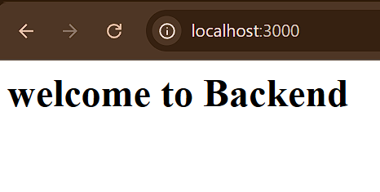
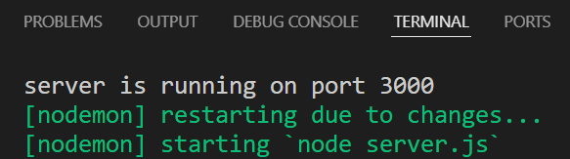
| Installing Express
How to Run Server ?
Expected Output
Step 1
Open terminal
Step 2
Run command:
node server.js
Step 3
Open browser:
localhost:3000
Browser:
Terminal:
Normally websites run on internet servers.
But while developing applications, we first run the server on our own computer for testing.
That local server is called:
localhost

Slide 19
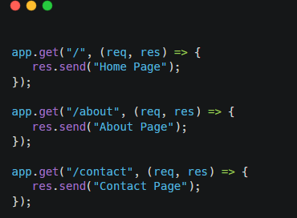
| Basic Routes
Expected Output
URL | Output
localhost:3000 | Home Page
localhost:3000/about | About Page
localhost:3000/contact | Contact Page

Slide 20
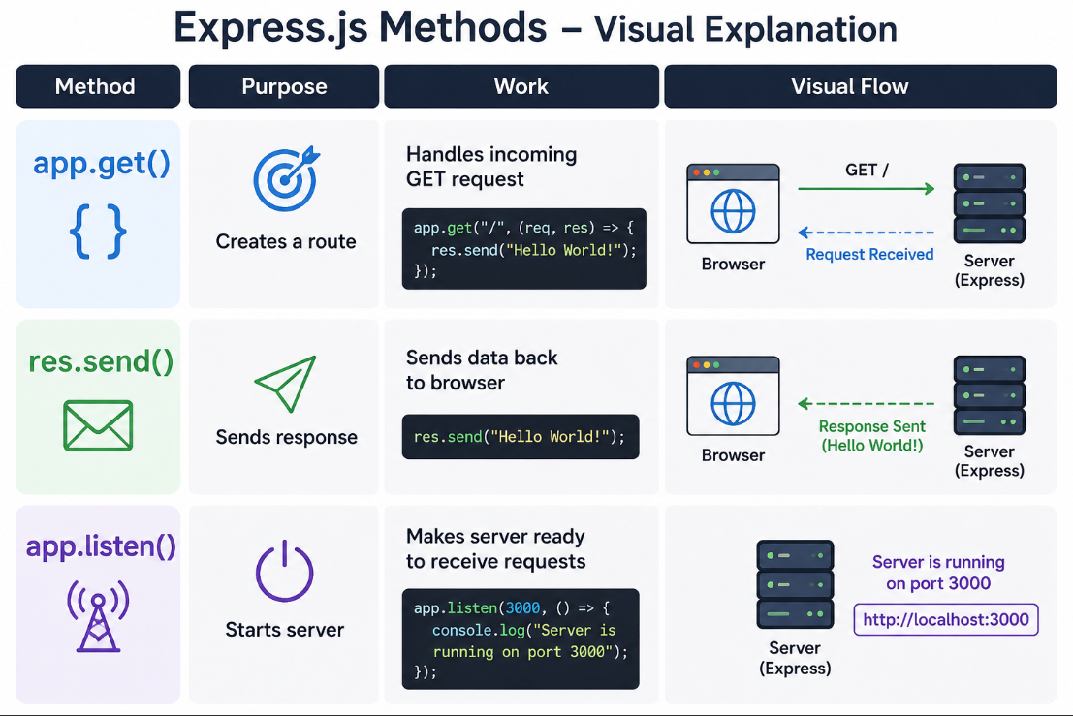
| app.get() vs res.send() vs app.listen()
Method | Purpose | Work
app.get() | Creates a route | Handles incoming GET request
res.send() | Sends response | Sends data back to browser
app.listen() | Starts server | Makes server ready to receive requests

Slide 21

| Check Your Understanding
Question : What is the purpose of require("express") in Express.js?
Options : A. Starts the server
B. Imports the Express package
C. Creates a route
D. Sends response to browser
Answer : B. Imports the Express package
Explanation:
require("express") is used to import the Express package into the project so we can use Express functionalities like routing and server creation.

Slide 22
| Check Your Understanding
Question : Which object contains information sent by the browser to the server?
Options : A. res B. app C. req D. express
Answer : C. req
Explanation:
req stands for request object. Basically, all information coming from client/browser is stored inside req.

Slide 23
| Check Your Understanding
Question : What is the main advantage of Express.js over the Node HTTP module?
Options : A. Express removes JavaScript
B. Express automatically creates database
C. Express reduces boilerplate code and simplifies backend development
D. Express works only with frontend
Answer : C. Express reduces boilerplate code and simplifies backend development
Explanation:
Using the HTTP module requires more manual coding for routes and request handling. Express provides simpler syntax and built-in features which make backend development faster and cleaner.

Slide 24
| References
MDN Web Docs : Comprehensive and official documentation for Express Js 🔗https://developer.mozilla.org/en-US/docs/Learn_web_development/Extensions/Server-side/Express_Nodejs
W3Schools : Beginner-friendly express tutorials with examples and interactive editors. 🔗https://www.w3schools.com/nodejs/nodejs_express.asp
Express Official- A comprehensive tutorial-style website that covers core Express JS concepts in depth.
🔗https://expressjs.com/en/

Slide 25
Thanks
For
Watching
Course - Web Development - III
welcome@krmangalam.edu.in
Sohna Road,Gurugram,Haryana 122103

